Slide 1
Association Rules
Market-Basket Analysis
Grocery Store: Large no. of ITEMS
Customers fill their market baskets with subset of items
98% of people who purchase diapers also buy beer
Used for shelf management
Used for deciding whether an item should be put on sale
Other interesting applications
  Basket=documents, Items=words
  Words appearing frequently together in documents may represent phrases or linked concepts. Can be used for intelligence gathering.

Slide 2
Association Rules
Purchasing of one product when another product is purchased represents an AR
Used mainly in retail stores to
    Assist in marketing
    Shelf management
    Inventory control
Faults in Telecommunication Networks, traffic analysis, document analysis, bioinformatics, computational chemistry,
Transaction Database
Item-sets, Frequent or large item-sets
Support & Confidence of AR

Slide 3
Types of Association Rules
Boolean/Quantitative ARs
Based on type of values handled
Bread ⇨ Butter (Presence or absence)
age(X, “30….39”) & income(X, “42K…48K”) ⇨ buys(X, Projection TV)
Single/Multi-Dimensional ARs
Based on dimensions of data involved
buys(X,Bread) ⇨ buys(X,Butter)
Single/Multi-Level ARs
Based on levels of Abstractions involved
age(X, “30….39”) ⇨ buys(X, laptop)
age(X, “30….39”) ⇨ buys(X, computer)

Slide 4
Support & Confidence
A rule must have some minimum user-specified confidence
  1 & 2 => 3 has 90% confidence if when a customer bought 1 and 2, in 90% of cases, the customer also bought 3.
A rule must have some minimum user-specified support
  1 & 2 => 3 should hold in some minimum percentage of transactions to have business value
AR X => Y holds with support T, if T% of transactions in DB that support X also support Y

Slide 5
Support & Confidence
Customer
buys both
Customer
buys diaper
Customer
buys beer

Slide 6
Support & Confidence
I=Set of all items
D=Transaction Database
AR A=>B has support s if s is the %age of transactions in D that contain AUB (both A & B)
s(A=>B )=P(AUB)
AR A=>B has confidence c in D if c is the %age of transactions in D containing A that also contain B
c(A=>B)=P (B/A)=P(AUB)/P(A)

Slide 7
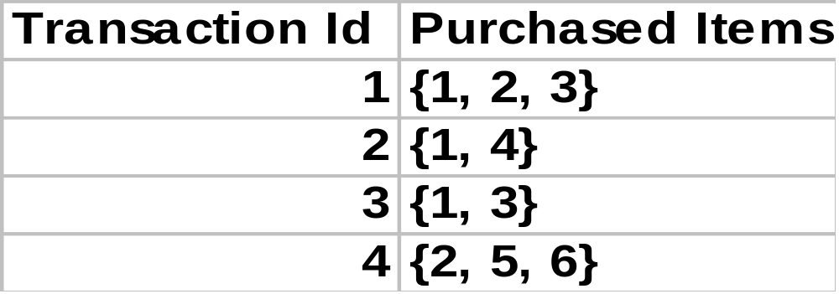
Example
  Transaction Database
For minimum support = 50%, minimum confidence = 50%, we have the following rules
  1 => 3 with 50% support and 66% confidence
  3 => 1 with 50% support and 100% confidence

Slide 8
Mining Associations Rules
2 Step Process
  Find all frequent Itemsets
  i.e. all itemsets satisfying min_sup
  Generate strong ARs from frequent itemsets
  i.e. ARs satisfying min_sup & min_conf

Slide 9
Frequent Itemsets (FIs)
Algorithms for finding FIs
    Apriori
    Sampling
    Partitioning
    Hash based Technique
    Transaction Reduction
    etc

Slide 10
Apriori Algorithm (Boolean ARs)
Candidate Generation
Level-wise search
Frequent 1-itemset (L₁) is found
Frequent 2-itemset (L₂) is found & so on…
Until no more Frequent k-itemsets (L_{k}) can be found
Finding each L_{k} requires one pass

Slide 11
Apriori Algorithm
Apriority Property
All nonempty subsets of a FI must also be frequent”
i.e., if {AB} is a frequent itemset, both {A} and {B} should
be a frequent itemset
Anti-Monotone Property
“If a set cannot pass a test, all its supersets will fail the test as well”
P(I) < min_sup ⇨ P(I U A) < min_sup, where A is any item
Property is monotonic in the context of failing a test

Slide 12
Frequent itemset /Apriori Property: example
If {a, c, d} is a large itemset then {a, c}, {a, d}, {c, d}, {a}, {c},{d}, {} are large itemsets too.
{}
a b c d
ab ac ad bc bd cd
abc abd acd bcd
abcd

Slide 13








Apriori Algorithm -Example
Database D
L₁
C₁
Scan D
C₂
C₂
L₂
Scan D
C₃
Scan D
L₃

Slide 14
Apriori Algorithm
2-Step Process
Join Step (candidate generation)
Guarantees that no candidate of length > k are generated using Lk-
Prune Step
Prunes those candidate itemsets all of whose subsets are not frequent

Slide 15
Candidate Generation
Given L_{k-1}
C_{k} = φ
For all itemsets l₁ ∈ L_{k-1} do
For all itemsets l₂ ∈ L_{k-1} do
If l₁[1] = l₂[1] ∧ l₁[2] = l₂[2] ∧…∧ l₁[k-2] = l₂[k-2] ∧ l₁[k-1] < l₂[k-1]
Then c= l₁[1], l₁[2], l₁[3]…. l₁[k-1], l₂[k-1]
C_{k} = C_{k} U {c}
Notes:
Conf = sup(LHS U RHS)
T=sup(LHS U RHS)/sup(LHS)

Slide 16
Example of Generating Candidates
L₃={abc, abd, acd, ace, bcd}
Self-joining: L₃*L₃
  abcd from abc and abd
  acde from acd and ace
Pruning:
  acde is removed because ade is not in L₃
C₄={abcd}

Slide 17
ARs from FIs
For each FI l, generate all non-empty subsets of l
For each non-empty subset s of l, output the rule s ⇒ (l-s) if support_count(l)
min_conf
≥
support_count(s)

Slide 18
Example
Suppose l = {2,3,5}
{2,3}, {2.5}, {3,5}, {2}, {3}, & {5}
Association Rules are
2,3 ⇒ 5 confidence 100%
2,5 ⇒ 3 confidence 66%
3,5 ⇒ 2 confidence 100%
2 ⇒ 3,5 confidence 100%
3 ⇒ 2,5 confidence 66%
5 ⇒ 2,3 confidence 100%

Slide 19
Apriori: Some Observations
C₂= L1*L1
No. of Candidates in C₂ = ^{L1}C₂
The larger the C₂ / C_{k} the more processing cost required to discover FIs

Slide 20
Variations of the Apriori
Many variations of the Apriori has been proposed that focus on improving the efficiency of the original algorithm
Hash-based technique- hashing itemset counts
Transaction reduction-reducing the number of transactions scanned in future iterations
Partitioning-partitioning the data to find candidate itemsets
Sampling-mining on a subset of the given data
Dynamic itemset counting-adding candidate itemsets at different points during a scan

Slide 21
Sampling Algorithm
Random transactions of the original database are selected (sampled) and placed in a much smaller sampled database.
The size of sampled database is small enough so that it can reside in main memory.
This reduces the number of (original) database scans to at most two.
Any standard algorithm, such as Apriori, can be used to create a set of large itemsets in sampled database.

Slide 22
Sampling Algorithm cont…
Since these large itemsets is applied to sampled database, some may not be the actual large itemsets of the original database. These itemsets are called potentially large itemsets, and PL denotes the set of potentially large itemsets.
Some actual large itemsets may not be in PL. Additional candidates for large itemsets are determined by applying negative border function, NB(), against PL.
Negative border returns the itemsets that are not in PL but has all of their subsets in PL.
Usually, the minimum support threshold is lowered when finding the PL from sampled database.

Slide 23
Sampling Algorithm : Algorithm
Sample transactions from Database D.
Using Apriori (or something else) algorithm to find PL from sampled database.
The candidate set C₁ contain itemsets from PL ∪NB(PL).
Scan the original database, check the support of each candidate in C₁. Those that meet the minimum support requirement will be added into L.
If some itemsets from NB(PL) were added into L in step 4.
Initially candidate set C₂ is equal to L.
Repeatedly add NB(C₂) into C₂ until no growth in C₂.
Scan the original database, check the support for each candidate in C₂ . Adding large itemsets into L.

Slide 24
Sampling Algorithm :Example
Let I = {a, b, c, d},
• After step 2, let PL = {{a}, {c}, {d}, {c, d}}.
• After step 3, C₁ = {{a}, {b}, {c}, {d}, {a, c}, {a, d}, {c, d},
{}
a b c d
ab ac ad bc bd cd
abc abd acd bcd
abcd C₁

Slide 25
Sampling Algorithm :Example
Assume that L = {{a},{c}, {d}, {a, c}, {a, d}, {c, d}} after the
database scan in step 4. Since {a, c} and {a, d} are in
NB(PL), we need to execute step 5. C₂ will be L U {{a, c, d}}.
{}
a b c d
ab ac ad bc bd cd
abc abd acd bcd
abcd
C₂

Slide 26
Partitioning
Instead of sampling transactions in database, the database D is subdivided into n partitions D₁, D₂, …, D_{n}.
Partitioning may improve the performance by:
– A large itemset must be large in at least one of the partitions.
– We can adjust the size of each partition so that it is small enough to fit in main memory.

Slide 27
Partitioning
Algorithm
Split database D into n partitions
Using apriori algorithm to find set of large itemset of each partition, Let L^{i} denote set of large itemsets of partition i.
Candidate set C = Un L^{i}
4. Scan the original database, check the minimum support of each candidate c in C. If the criteria is met, add c into L.

Slide 28
Partitioning: Example
A1
A2
A3
A4
A5
A6
A7
A8
A9
1
0
0
0
1
1
0
1
0
0
1
0
1
0
0
0
1
0
0
0
0
1
1
0
1
0
0
0
1
1
0
0
0
0
0
0
0
0
0
0
1
1
1
0
0
σ = 20%
0
1
1
1
0
0
0
0
0
0
1
0
0
0
1
1
0
1
0
0
0
0
1
0
0
0
0
0
0
0
0
0
0
0
1
0
0
0
1
0
1
0
1
0
0
0
0
1
0
1
0
1
0
0
0
0
0
0
1
1
0
1
0
0
1
0
1
0
1
1
0
0
1
0
1
0
1
0
1
0
0
0
1
1
0
0
0
0
0
1

Slide 29
Partitioning: Example
Apriori:
L₁=
{2}
6
L₂=
{2,3}
3
L₃=
{3,5,7}
3
{3}
6
{2,4}
3
{4}
4
{3,5}
3
{5}
8
{3,7}
3
{6}
5
{5,6}
3
{7}
7
{5,7}
5
{8}
4
{6,7}
3
The Frequent set L=L₁∪L₂ ∪ L₃

Slide 30
Partitioning: Example
Dividing database in 3 equal partitions. Local support=20%=σ₁=σ₂=σ₃=σ
{{1}, {2}, {3}, {4}, {5}, {6}, {7}, {8}, {1,5}, {1,6}, {1,8}, {2,3}, {2,4}, {2,8}, {4,5}, {4,7}, {4,8}, {5,6}, {5,8}, {5,7}, {6,7}, {6,8}, {1,6,8}, {1,5,6}, {1,5,8}, {2,4,8}, {4,5,7}, {5,6,8}, {5,6,7}, {1,5,6,8}
L¹=
L²={……}
L³={…….}
The candidate set C=L¹∪L² ∪ L³
Read database once to compute the global support of
the sets in C and get the final set of frequent itemsets L

Slide 31
Hash-Based Algorithm
The larger the C_{k} the more processing cost required to discover FIs
Reduces the size of C_{k} for k>1
DHP( Direct hashing and pruning) or PCY has 2 major features
  Efficient generation for FIs (2-itemsets)
  Reduction of Tr. DB size (right after the generation of large 2-itemsets)

Slide 32
Hash-Based Algorithm
Efficient counting
For each Tr. After 1-itemsets are counted, 2-itemsets of the Tr. are generated and hashed into a hash table H₂
Subset function: finds all the candidates contained in a transaction
When a 2-itemset is hashed to a bucket, the count of the bucket is incremented

Slide 33
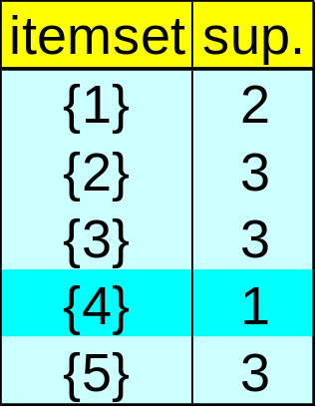
Hash-Based Algorithm:
Example
C₁
L₁
L1*L1=({1,2},{1,3},{1,5},{2,3} {2,5},{3,5})

Slide 34
Hash-Based Algorithm:
Example (generating C₂)
C₂
{1,3}
{2,3}
{2,5}
{3,5}
100
(1,3) (1,4), (3,4)
200
(2,3) (2,5), (3,5)
H(x,y)= {(order of x)*10+
(order of y)} mod 7
300
(1,2) (1,3), (1,5), (2,3), (2,5), (3,5)
400
(2,5)
3,5
3,5
1,4
1,5
2,3
2,3
2,5
2,5
2,5
1,2
1,3
3,4
1,3
Hash Table H₂
count
3
0
1
1
2
2
0
3
3
4
1
5
3
6
Bucket no
1 0 1 0 1 0 1 Bit Vector
L1*L1=({1,2},{1,3},{1,5},{2,3} {2,5},{3,5})
1 3 1 2 3 3 No. in the bucket with itemset

Slide 35
Multiple-Level Association Rules
Items often form hierarchy.
Items at the lower level are expected to have lower support.
Rules regarding itemsets at appropriate levels could be quite useful.
Food
milk
bread
skim
2%
wheat
white
Fraser
Sunset
milk ⇒ bread [20%, 60%]
2% milk ⇒ wheat bread [6%, 50%].

Slide 36
Multiple-Level Association Rules
mining multilevel association rules.
  2% milk ⇒ wheat bread
  2% milk ⇒ bread

Slide 37
Multi-level Association: Uniform Support vs. Reduced Support
Uniform Support: the same minimum support for all levels
  + One minimum support threshold. No need to examine itemsets containing any item whose ancestors do not have minimum support
  – Lower level items do not occur as frequently. If support threshold
    too high ⇒ miss low level associations
    too low ⇒ generate too many high level associations
Reduced Support: reduced minimum support at lower levels

Slide 38
Uniform Support
Level 1
min_sup = 5%
Milk
[support = 10%]
Level 2
min_sup = 5%
2% Milk
[support = 6%]
Skim Milk
[support = 4%]

Slide 39
Reduced Support
Level 1
min_sup = 5%
Milk
[support = 10%]
Level 2
min_sup = 3%
2% Milk
[support = 6%]
Skim Milk
[support = 4%]

Slide 40
Multi-level Association: Redundancy Filtering
Some rules may be redundant due to “ancestor” relationships between items.
Example
  milk ⇒ wheat bread [support = 8%, confidence = 70%]
  2% milk ⇒ wheat bread [support = 2%, confidence = 72%]
We say the first rule is an ancestor of the second rule.
A rule is redundant if its support is close to the “expected” value, based on the rule’s ancestor.

Slide 41
Multi-Dimensional Association: Concepts
Single-dimensional rules:
    buys(X, “milk”) ⇒ buys(X, “bread”)
Multi-dimensional rules:  2 dimensions or predicates
  Inter-dimension association rules (no repeated predicates)
  age(X,”19-25”) ∧ occupation(X,“student”) ⇒ buys(X,“coke”)
  hybrid-dimension association rules (repeated predicates)
  age(X,”19-25”) ∧ buys(X, “popcorn”) ⇒ buys(X, “coke”)
Categorical Attributes
  finite number of possible values, no ordering among values
Quantitative Attributes
  numeric, implicit ordering among values

Slide 42
Techniques for Mining MD Associations
Search for frequent k-predicate set:
  Example: {age, occupation, buys} is a 3-predicate set.
  Techniques can be categorized by how age are treated.
1. Using static discretization of quantitative attributes
  Quantitative attributes are statically discretized by using predefined concept hierarchies.
2. Quantitative association rules
  Quantitative attributes are dynamically discretized into “bins”based on the distribution of the data.
3. Distance-based association rules
  This is a dynamic discretization process that considers the distance between data points.

Slide 43
Static Discretization of Quantitative Attributes
Discretized prior to mining using concept hierarchy.
Numeric values are replaced by ranges.
In relational database, finding all frequent k-predicate sets will require k or k+1 table scans.
Data cube is well suited for mining.
The cells of an n-dimensional
cuboid correspond to the predicate sets.
Mining from data cubes
can be much faster.
Discretized prior to mining using concept hierarchy.
Numeric values are replaced by ranges.
In relational database, finding all frequent k-predicate sets will require k or k+1 table scans.
Data cube is well suited for mining.
The cells of an n-dimensional
cuboid correspond to the predicate sets.
Mining from data cubes
can be much faster.
()
()
()
(age)
(age)
(age)
(income)
(income)
(income)
(buys)
(buys)
(buys)
(age, income)
(age, income)
(age, income)
(age,buys)
(age,buys)
(age,buys)
(income,buys)
(income,buys)
(income,buys)
(age,income,buys)
(age,income,buys)
(age,income,buys)
(age,income,buys)

Slide 44

Quantitative Association Rules
Numeric attributes are dynamically discretized
  Such that the confidence or compactness of the rules mined is maximized.
2-D quantitative association rules: A_{quan1} ∧ A_{quan2} ⇒ A_{cat}
Cluster “adjacent”
  association rules
  to form general
  rules using a 2-D
  grid.
Example:
age(X,”34-35”) ∧ income(X,”24K - 48K”)
⇒ buys(X,”high resolution TV”)

Slide 45
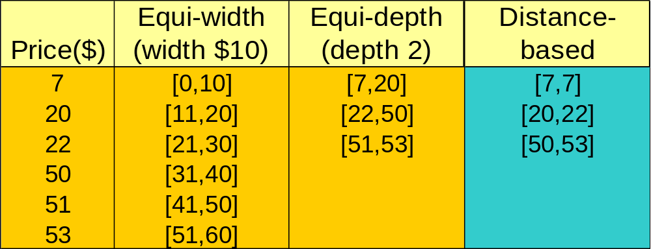
Mining Distance-based Association Rules
Binning methods do not capture the semantics of interval data
Distance-based partitioning, more meaningful discretization considering:
  density/number of points in an interval
  “closeness” of points in an interval

